Slide 1
CS4499/5599: Data Science and Applied Machine Learning
Class Lecture: April 5th, 2023

Slide 2
Objectives
Last time:
Finished up ensembles methods by going over gradient boosting and stacking
Began discussing logistic regression
Today:
Go over multi-class logistic regression
Discuss k-nearest neighbors

Slide 3
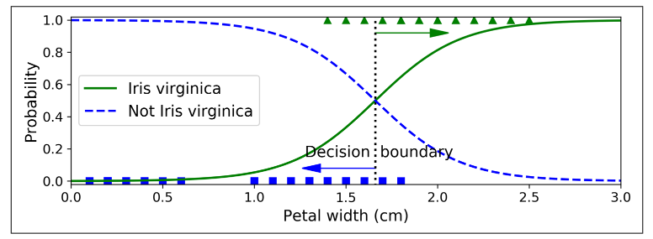
Multi-class Logistic Regression
Last time we performed a simple classification using the logistic regression classifier
We were able to produce a similar graph to this one:

Slide 4
Multi-class Logistic Regression
You will notice from the graph that we can only use this with 2 classes (a binary classification)
The good news is we can address this issue using a heuristic approach to split our multiclass problem into several different binary classifiers
There are two approaches we can use to create our different binary classifiers
One Vs One
One Vs Rest

Slide 5
One Vs. One
The first approach to training the multiple binary classifiers is the One Vs. One (OvO) approach
With this we take a single class from our dataset and train a binary model for every other class in the dataset, this process is repeated for every class in the dataset
Consider the Iris dataset we have been working with, we have 3 classes Iris Virginica, Iris Sentosa and Iris Versicolour
Using the OvO approach we would train a model for each possible combination of these three classes

Slide 6
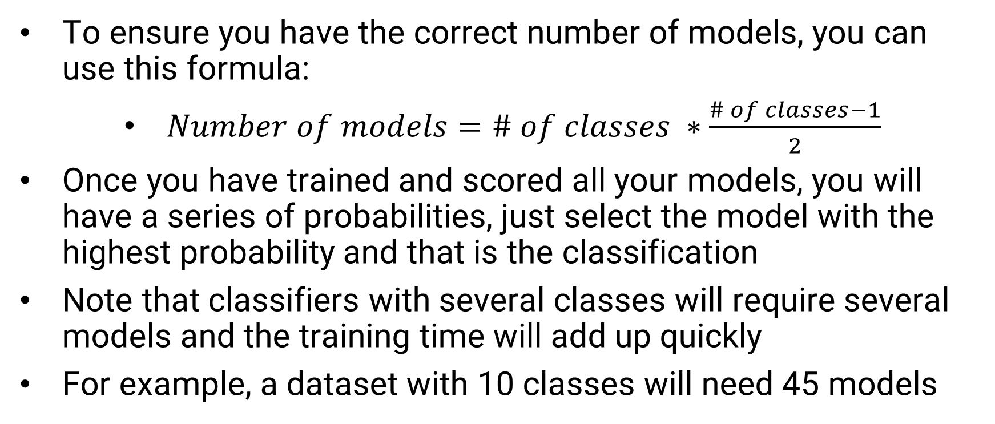
One Vs. One
To ensure you have the correct number of models, you can use this formula:
$Number of models=\# of classes ∗\frac{\# of classes−1}{2}$
Once you have trained and scored all your models, you will have a series of probabilities, just select the model with the highest probability and that is the classification
Note that classifiers with several classes will require several models and the training time will add up quickly
For example, a dataset with 10 classes will need 45 models

Slide 7
One Vs Rest
One Vs Rest (OvR) or sometimes known as One Vs All is the most common approach to take binary classifiers and train multi-class models (at least for logistic regression)
With the OvR approach, we train a binary classifier for each class against all the remaining classes
Again, consider the Iris dataset, with, a OvR approach we would take the 3 classes and train these 3 models:
Iris Virginica Vs Iris Sentosa and Iris Versicolour
Iris Sentosa Vs. Iris Virginica and Iris Versicolour
Iris Versicolour Vs. Iris Sentosa and Iris Virginica

Slide 8
One Vs Rest
As was the case for the OvO approach, each of the models will then produce a class probability and the highest score would then be chosen for the classification
The drawback of this is that you still must train multiple models and as your class number grows, the time needed to train the models will also increase
Though the effect is much less with OvR than the OvO approach
Sklearn has a built-in OneVsRest classifer class, however, the Sklearn logistic regression class will use this automatically when we provide a multi-class dataset

Slide 9


Softmax Regression
If we do not want to train several binary classifiers for our logistic regression model, we can use the softmax approach
In this case when we give the model an instant X, the model computes a score for each class, using this equation:
Using this score, the model then applies the softmax function to determine the probability of the instance belonging to each class:

Slide 10
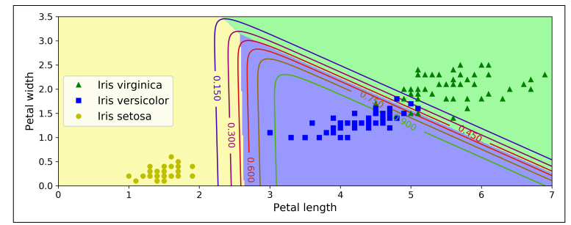
Softmax Regression
Just like the two heuristic techniques, the class with the highest probability is chosen for the classification
Visualization of Softmax regression’s decision boundaries

Slide 11
Softmax Regression
The sklearn logistic regression class supports using softmax regression by specifying multi-nominal for the multi_class hyperparameter
Sklearn also has several optimizers that can be used to improve the training of the model such as lbfgs and newton-cholesky
Once we train the model, we can use the .predict_prob method to get an array of the different probabilities for each class
Logistic regression models assume that are variables are statistically independent from one another, also these type of models do not handle major outliers well

Slide 12
k-Nearest Neighbors
K-nearest neighbors(kNN) is another common machine learning technique that can be used for both regression and classification
Like the decision tree model, kNN is non-parametric, meaning that the model doesn’t rely on mathematical assumptions (as logistic regression)
This method was first developed in the early 1950s and has been built upon ever since
kNN is a supervised learning model, but can be confused with a similar unsupervised approach k-means

Slide 13
k-Nearest Neighbors
kNN relies on the assumption that items of a class will have similar characteristics to each other (i.e., similar features)
kNN is known as a “lazy” operator, as the only major step in training the model is storing data
A good way of visualizing a kNN model is to think of it as graphing data on a standard X,Y plot
While we can only visualize a small number of dimensions we can have as many dimensions as we want
Once our data is plotted, we make our predictions based on the distance between the testing point and our training data

Slide 14
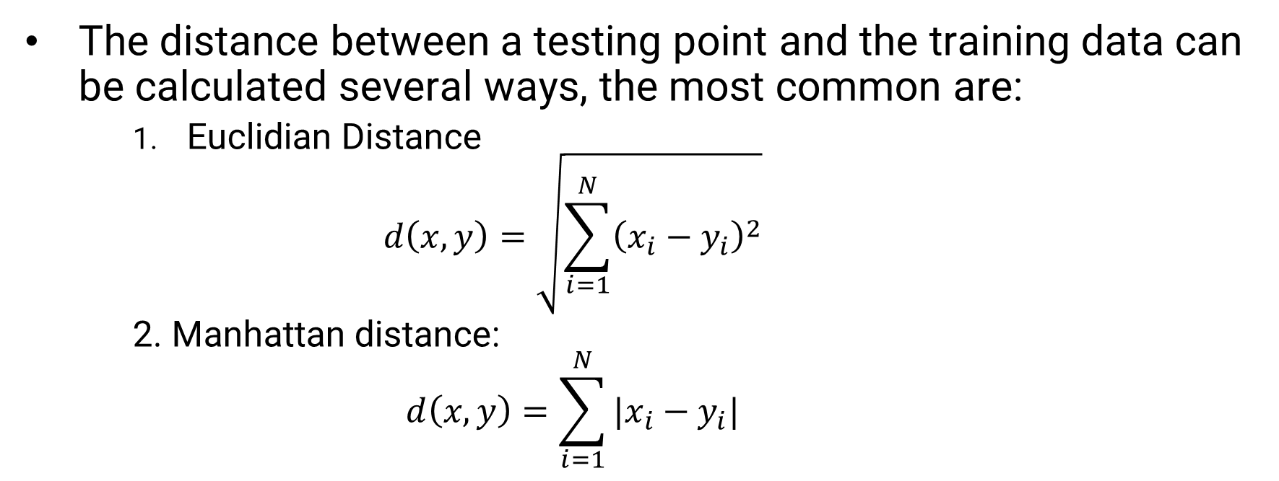
k-Nearest Neighbors
The distance between a testing point and the training data can be calculated several ways, the most common are:
Euclidian Distance
$$d\left(x,y\right)=\sqrt{\sum_{i=1}^{N}{{\left(x_{i}−y_{i}\right)}^{2}}}$$
2. Manhattan distance:
$$d\left(x,y\right)=\sum_{i=1}^{N}{|x_{i}−y_{i}|}$$

Slide 15
k-Nearest Neighbors
There are other approaches (Hamming, Minkowski, etc.), but these two are most common
Once the distance between points is known, the classification is based on the number of point that is closest to the testing sample
This number of points is known as ‘k’, and can be set at any integer the users wants
However, the classification is based of majority vote (or plurality for multi-class), so it is HIGHLY recommended to use an odd value to deal with any ties

Slide 16
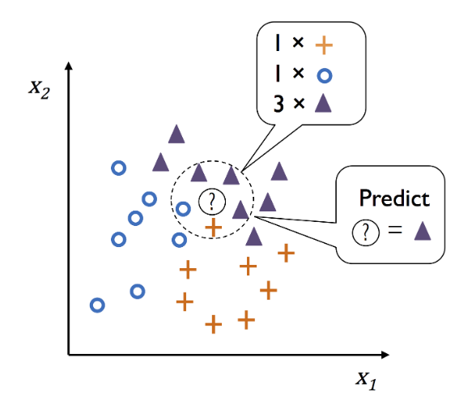
k-Nearest Neighbors
Source: Sebastian Raschka, University of Wisconsin-Madison

Slide 17
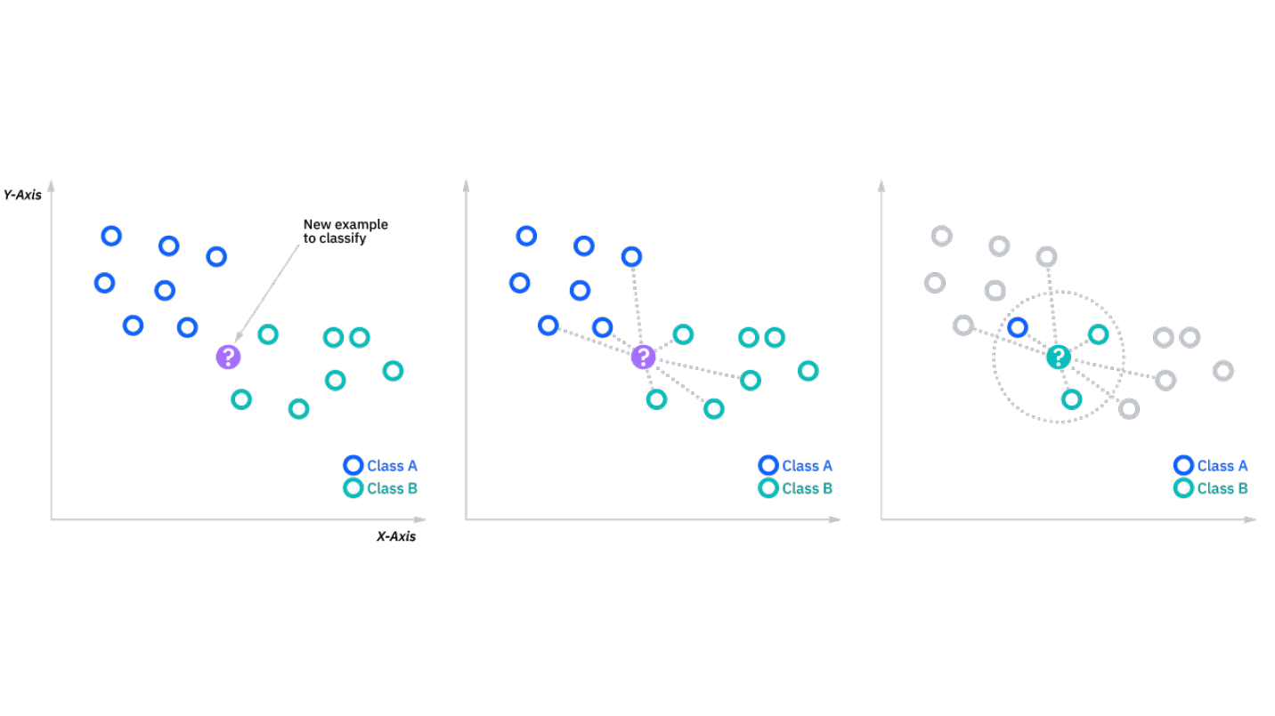
k-Nearest Neighbors
Source: IBM -Nearest Neighbors Algorithm

Slide 18
kNN Regression
kNN can also be applied to regression problems
The goal of the training data is still the same (i.e., we are still looking for the nearest points relative to our sample)
However, once we have the nearest “neighbors” we average out their value to derive the prediction for our sample
Many algorithms have support to make this a weighted average (i.e., the closer points will have more impact than the farther away neighbors)
We still evaluate the models based of MSE, RMSE and R²

Slide 19
kNN Pros & Cons
kNN has a number of advantages that make it a powerful option for machine learning:
Simple to implement (O(n) typically)
Easy to adapt to new data (quick training)
Few major hyperparameters (really just k and the distance metric)
Some disadvantages of kNN include:
The model will take up more space as more dimensions are added (if you have a huge dataset, you might have issues)
kNN starts to overfit badly once the number of features gets high (The Curse of Dimensionality)
Very susceptible to changes in k (especially regression)

Slide 20
Final Thoughts on kNN
kNN works great as a techniques to estimate missing values in your data
kNN has historically been popular in the finance industry for things like credit assessments (in part due to its transparency)
It has also been used in healthcare and pattern recognition
Don’t hesitate to try out different values for k. A higher k value can make your model more robust against outliers
That said if you are experiencing an overfit models lowering the k value might help

Slide 21
Next Time
Wrap up Supervised Learning Methods:
Naïve Bayes
Support Vector Machines
Homework 7 will be assigned on Monday 4/10
Graduate student project proposals are due 4/12

